Slide 1
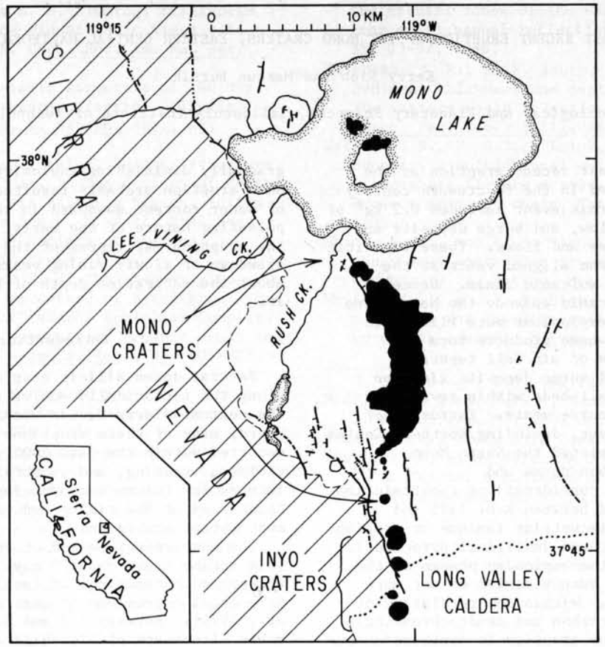
Most Recent Eruption of the Mono Craters, Eastern Central California
Sieh & Bursik, 1986
GEOL 730
Yair Franco

Slide 2
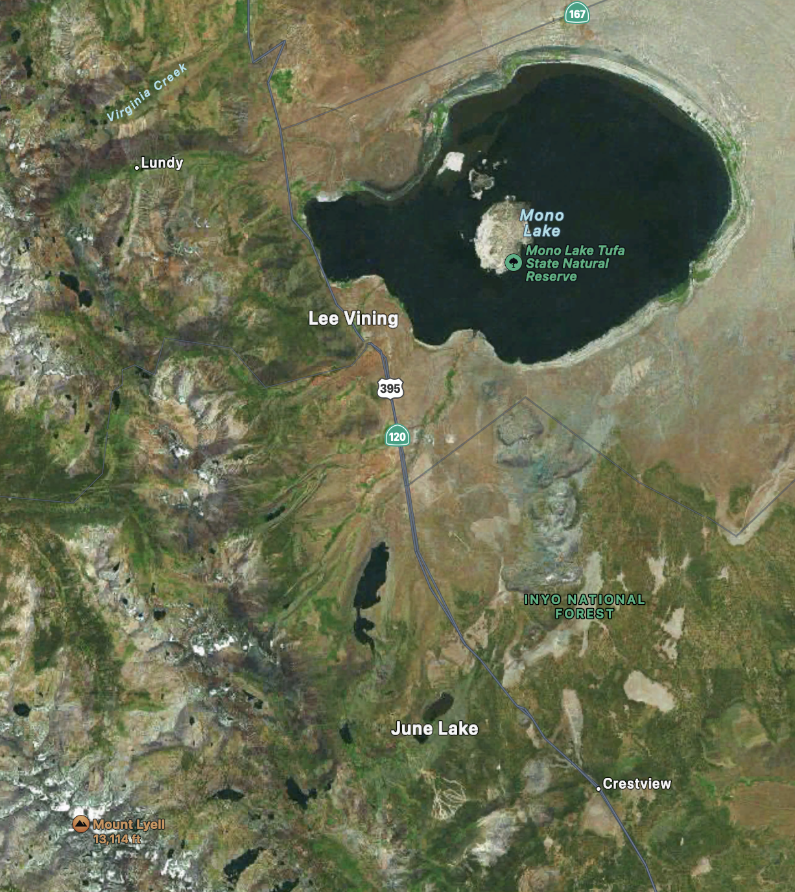

Slide 3
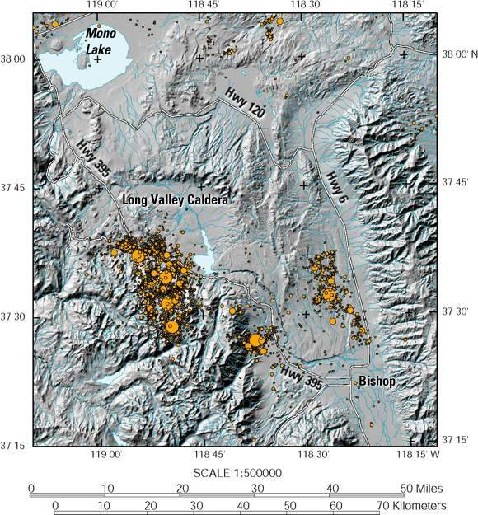
Motivation
Eastern flank of Sierra Nevada is volcanically active
Nearby Long Valley Caldera formed 0.7 Ma, peak activity
Very young volcanic deposits from Long Valley Caldera to Mono Lake
Notes:
Can this tell us about the future of volcanic activity along the eastern Sierra?

Slide 4
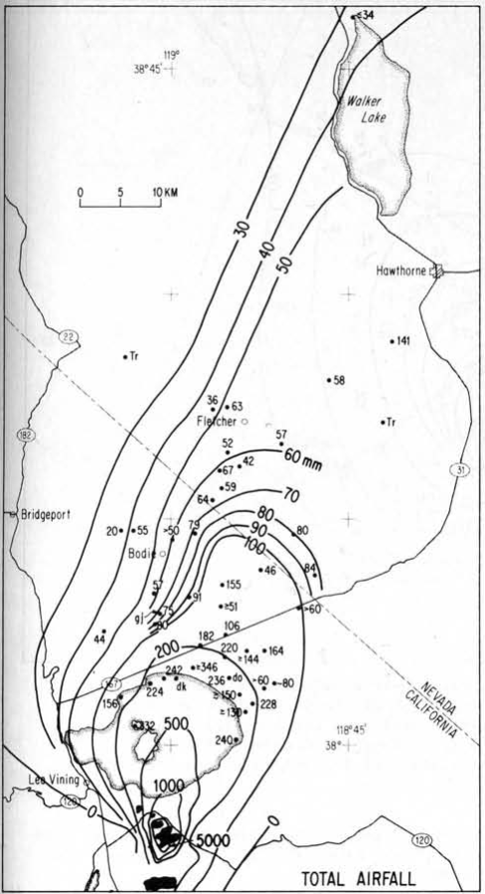
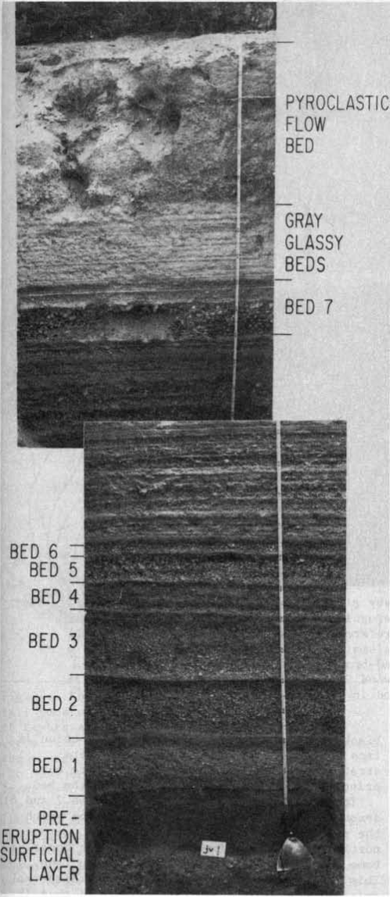
Air Fall Beds
Tephra largely composed of fine white pumice, glass and obsidian dust (high-silica rhyolite)

Slide 5
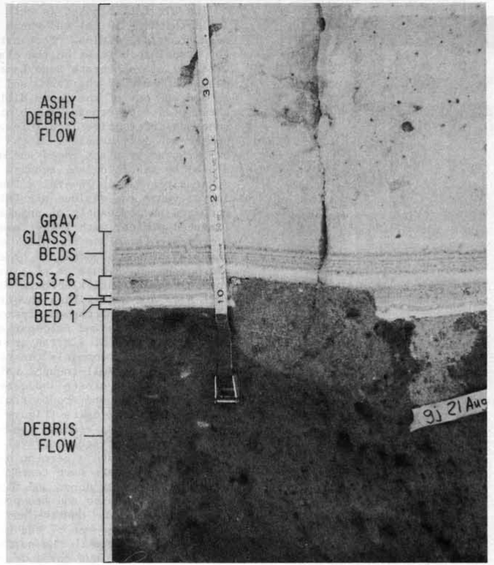
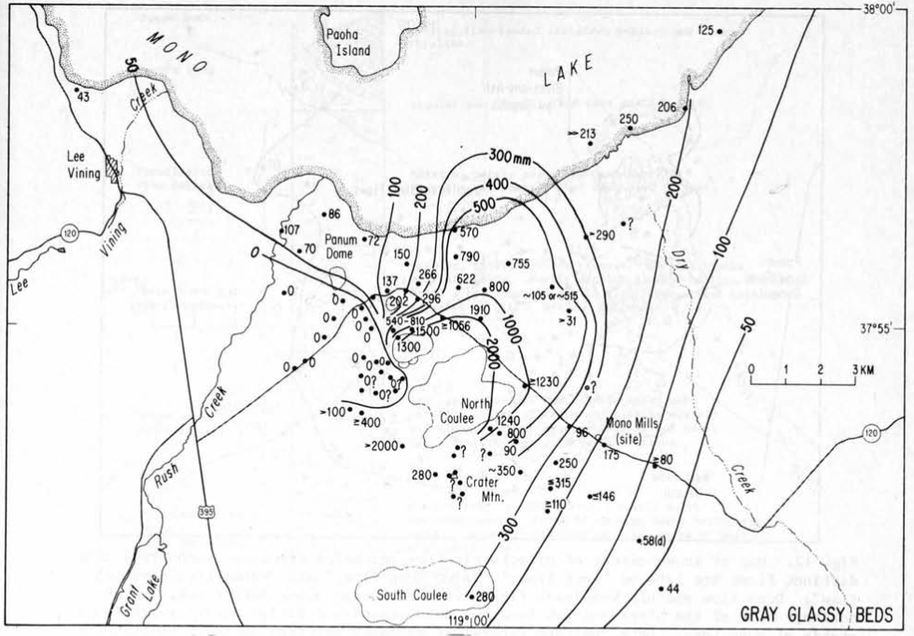
Air Fall Beds
Gray glassy beds overlie the initial eruptive beds

Slide 6
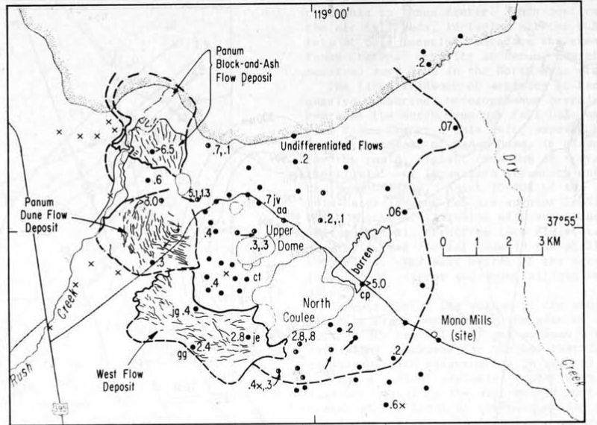
Pyroclastic Flow Deposits
Large pyroclastic flow deposits found within several km of source vents

Slide 7
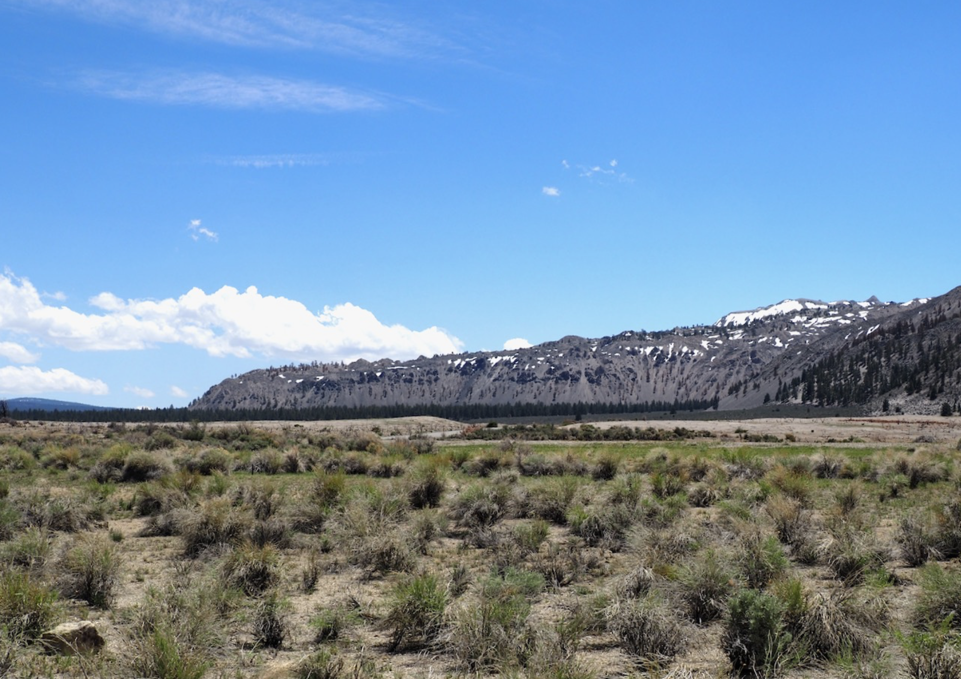
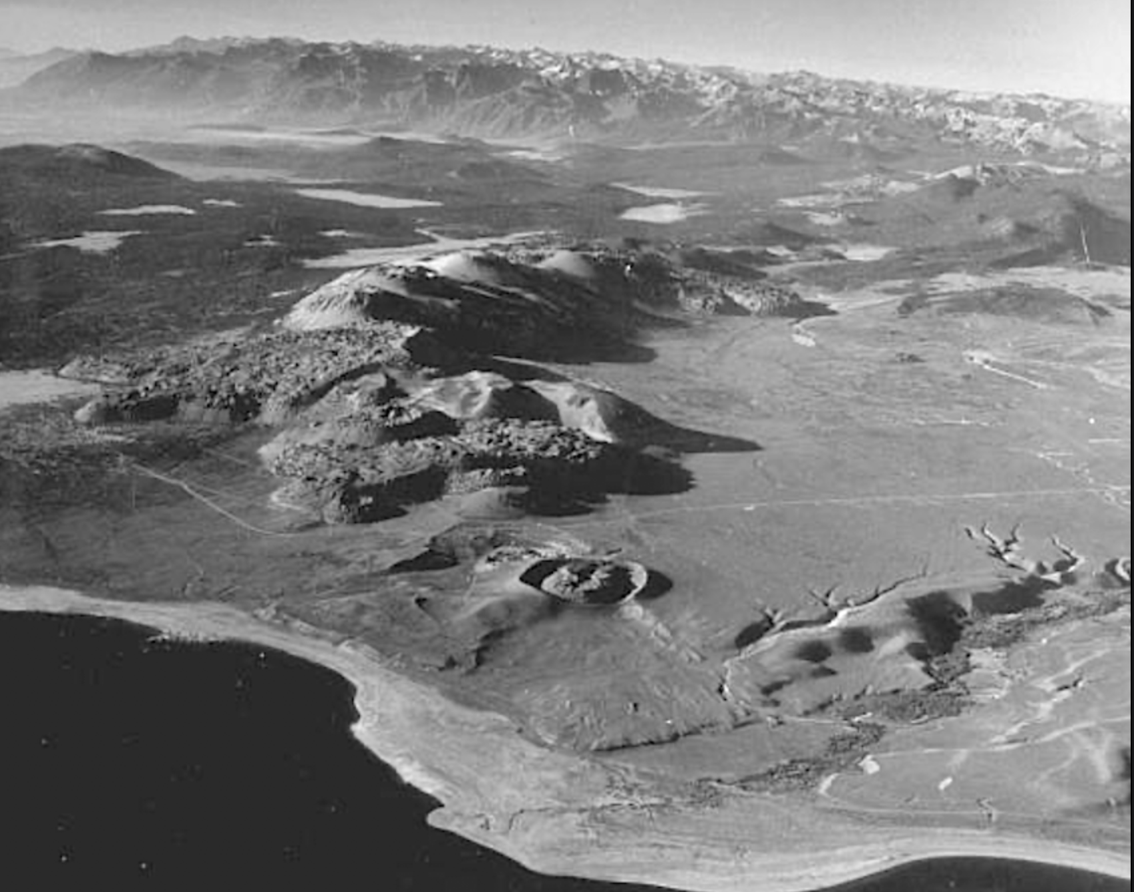
Domes and Coulees
Five domes and lava flows extruded during North Mono eruption
Notes:
Beds 6 and 7:

Slide 8
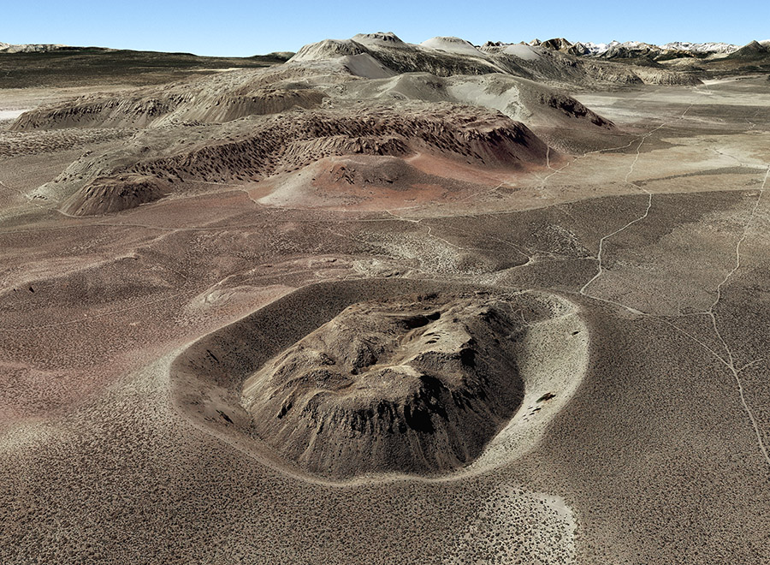
Panum Crater
Vent is distant enough from other sources that its deposits are simple and not mixed up
Rhyolite dome surrounded by a tephra ring
Notes:
Since it’s not mixed up, Panum crater has the cleanest observations of eruptive layers

Slide 9
Panum Crater
Deposits:
Throat-clearing breccia: created by rapid, violent opening of the crater
Panum Dune flow deposit: subsequent pyroclastic flow
Pyroclastic surge beds: mix of pyroclastic and air fall beds
Block-and-ash flow deposit: massive breccia, possibly from dome collapse or explosion
Tephra ring: last pyroclastic deposit
Panum crater deposits are younger than the larger tephra beds

Slide 10
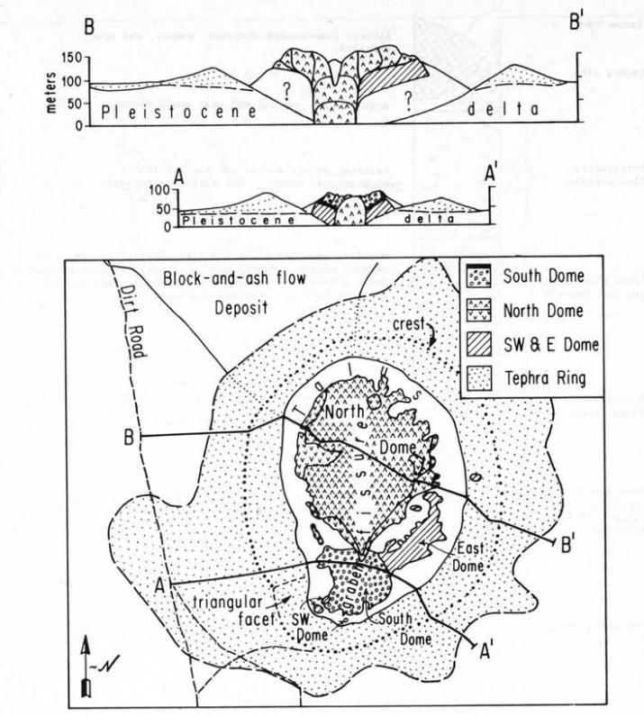
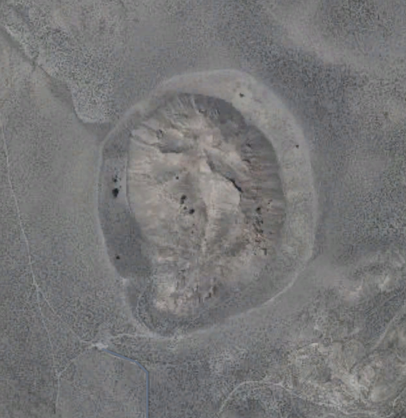
Panum Dome
Comprised of multiple fractured domes
North Dome is the youngest and largest
Notes:
Attention to the fissure

Slide 11
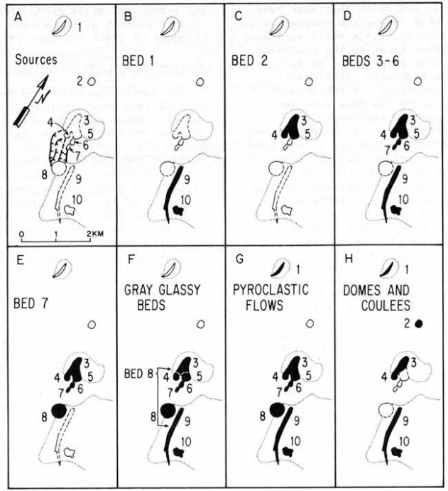
Eruptive Region
Notes:
Sources for each formation found based on isomaps and crater observations

Slide 12
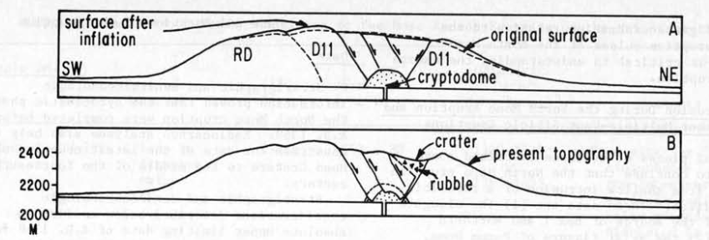
Eruptive region
Notes:
Graben/normal faults moved during eruptions by inflation of a cryptodome. Faults are linear, like a fissure

Slide 13
Source
This eruption may have been caused by shallow rhyolitic intrusion
Elongated nature of source of bed 1
Fissure on Panum Dome
Linearity of vents
Compositional uniformity
Linear graben
Simultaneity

Slide 14
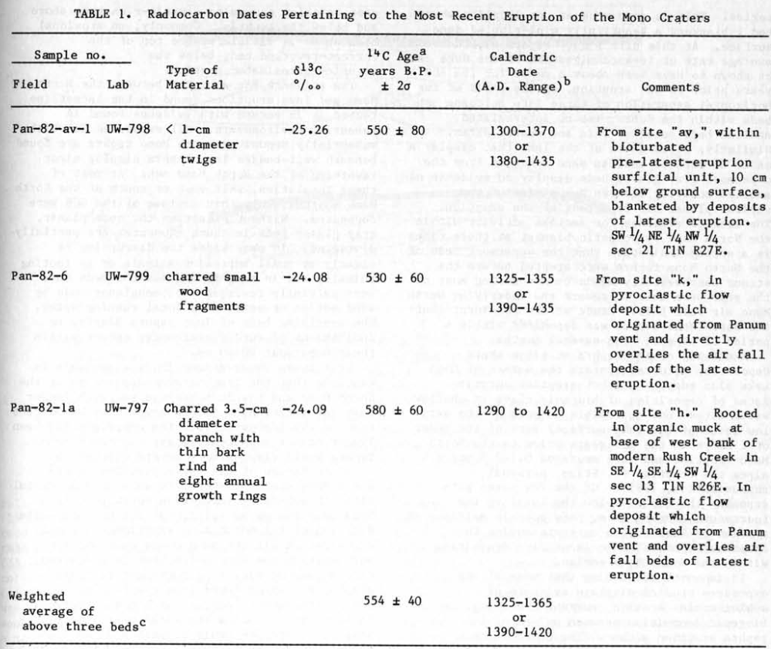
Date and Duration
Date of eruption: 1369 A.D.
Found via stratigraphy, dendrochronology, and carbon dating
Duration: 1-2 years
No aeolian or lacustrine alteration between eruptive deposits
Notes:
Trees growing on pyroclastic flows that only get as old as 1369
More evidence for a hiatus between mono and inyo eruptions, but not for the different pulses of the north inyo eruption

Slide 15
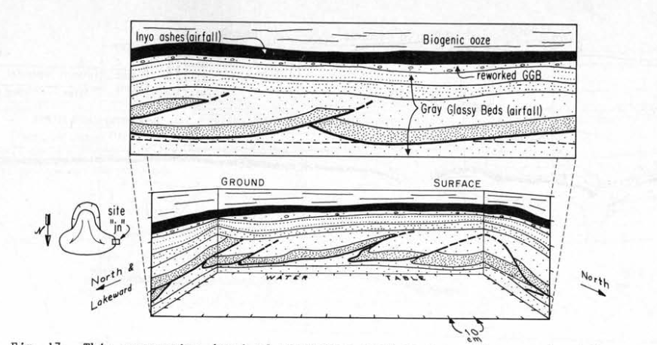
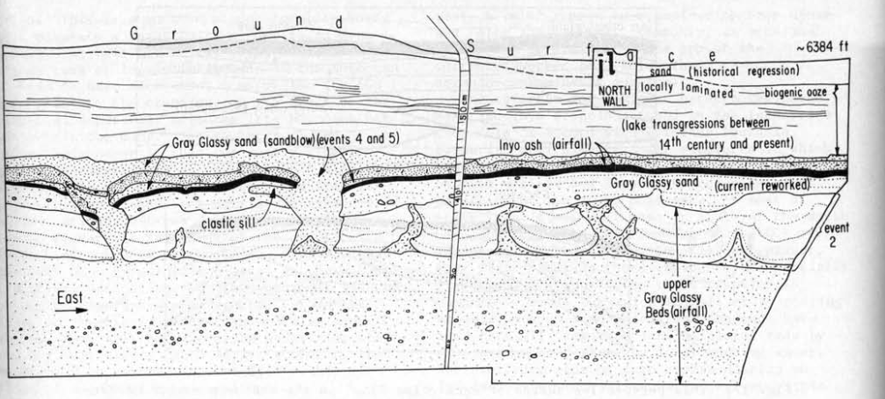
Seismicity
Ground failure and liquefaction evidence suggest strong (>M5.5) earthquakes during the eruptions
Notes:
Mechanism: sand moving above emplaced layers by movement due to density

Slide 16
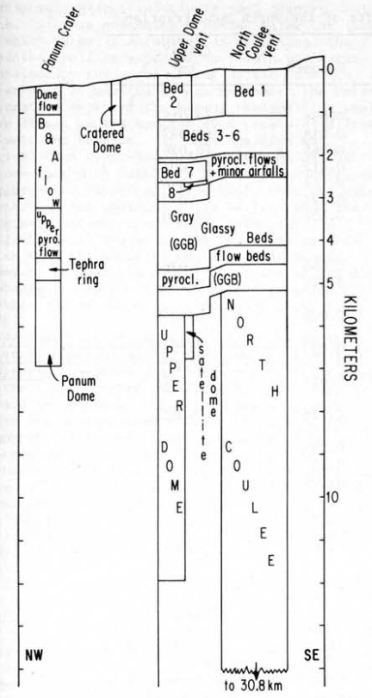
Cause and Nature of Eruption
Intrusion was a result of extensional stress
Movement and faulting was caused by magma pressure, not just elastic rebound
Shallow water mixing caused explosivity, then led to effusive activity
Notes:
As water filled units were erupted they were replaced with magma with less water, those being less explosive

Slide 17
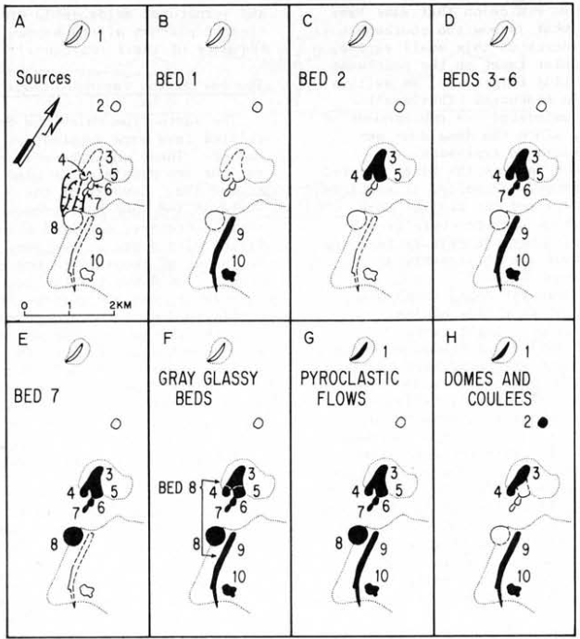
Summary
North Mono eruption ended around 1369 A.D.
Initial explosive phase followed by dome resurgence
Caused by a long magmatic intrusion, accommodating extensional stress

Slide 18
Abstract
Last eruption 14th century A.D. (North Mono eruption)
Pyroclastic flow and surge deposits over air fall tephra
Extrusion concluded eruption
Radiocarbon and dendrochronology -> 1325-1365 AD
Deposits suggest eruption was quick
North Mono tephra probably 1-2 years before Inyo Tephra
Liquefaction evidence -> strong earthquakes during eruptions
Eruption caused by a dike intrusion and magma mixing

